Slide 1
Microsoft Power Platform + Dynamics 365
Notes:
Hi, Welcome to Microsoft Power Platform + Dynamics 365 Bootcamp.

Slide 2
Course Overview
Day 1
Empowering Everyone with Power Platform – From CEO to Frontline Workers
Introduction to Power Platform
Day 2
Power Packed Day with Power Canvas Apps
Introduction to PowerApps
Day 3
Power Packed Day with Power Model Driven Apps
Let’s talk about data
Day 4
Power Packed Day with Power Automate
Introduction
Day 5
Power Packed Day with Power Virtual Agents
Introduction
Microsoft Power Platform momentum
Why Power Platform?
Customer Stories
Demo
Benefits of PowerApps
What can I build with PowerApps?
Types of PowerApps
Canvas Apps
Data Sources and Connectors
Demo
Types of flow
Data types and expression
Working with Arrays
Control flow and action settings
Demo
Types of Data
Common Data Service
Model-driven Apps
What type of components can I add?
Data model design
Demo
A Robust Virtual Agent Platform
Converse everywhere
Easily make your bots better
Create personalized customer experiences
Transfer to a human agent
Built on Power Platform & Azure Bot Service
Extend your bot capabilities with Azure Bot Service
Demo

Slide 3
Continue…
Day 6
Power Packed Day with Power BI
Introduction
Day 7
Power up your Apps with AI Builder
Introduction
Day 8
Power Platform Administration, Security & Integration Connectors
Introduction
Day 9
Power Packed Bizz Apps Day – Sales & Marketing
Introduction
Day 10
Power Packed Bizz Apps Day– Finance & Supply Chain
Introduction
AI for every app. And everyone
Setup Environment
Types of AI Model
Prediction
Form processing
Object detection
Text classification
Demo
The 5x5 Principle
Customer momentum: Power BI
Power BI Desktop
Data sources
Power Query
Dataflow
Using a Calculation (DAX) in multiple files
Paginated Reporting
Power BI Admin Portal
Demo
Secure your tenant
Monitor your tenant’s activity
Alert & act on that activity
Connectors
SharePoint Integration
Demo
Nurture more demand
Personalize buyer experiences
Build relationships at scale
Make insight-driven decisions
Demo
How to embed Power BI in Dynamics 365 for Sales and Marketing
Technology Modernization
Modern Finance
Supporting modern supply chain management
Demo
How to embed Power Platform in Dynamics 365 for Finance and Supply Chain

Slide 4
Day 6: Power Packed Day with Power BI

Slide 5

Agenda
Introduction
The 5x5 Principle
Customer momentum: Power BI
Power BI Desktop
Data sources
Power Query
Dataflow
Using a Calculation (DAX) in multiple files
Paginated Reporting
Power BI Admin Portal
Demo
Building your Power BI report for Dynamics 365

Slide 6

Power BI: experience your data Any data, any way, anywhere
Web
Mobile
Excel
Cloud data
Power BI
Embedded
HoloLens
On-premises data
“……”

Slide 7
1
2
3

Slide 8
1
2
3
The 5x5 Principle
5 Seconds to Signup
5 Minutes to Wow

Slide 9
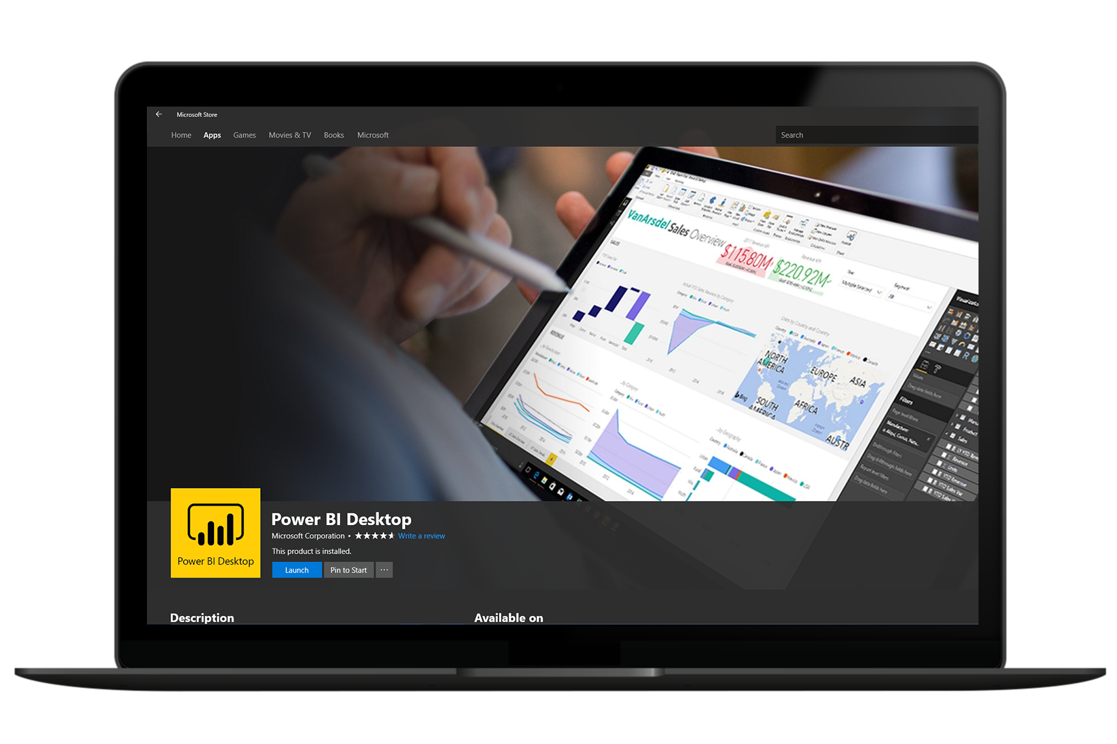
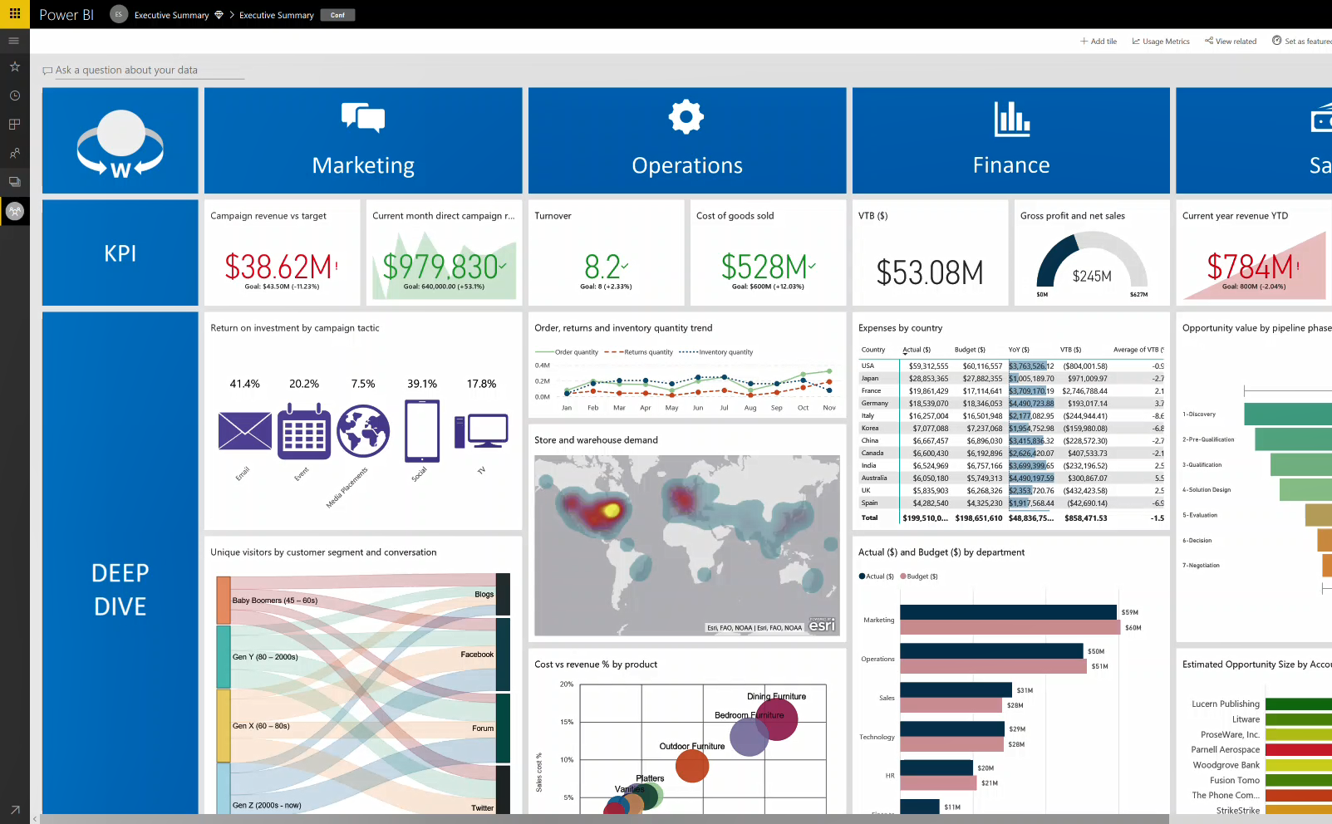
1
2
3
Get started
in minutes

Slide 10



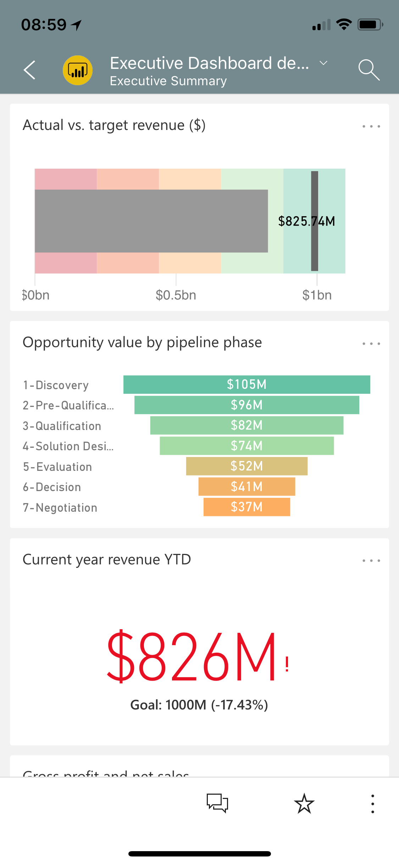
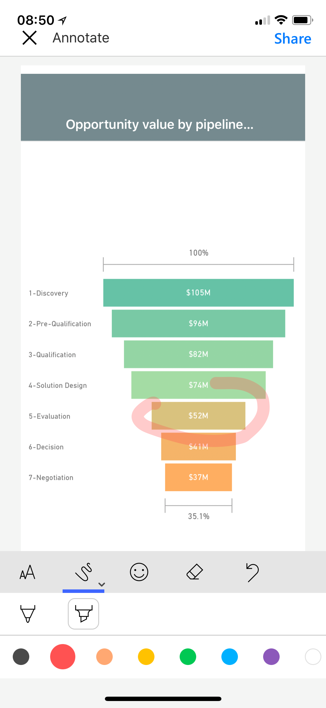
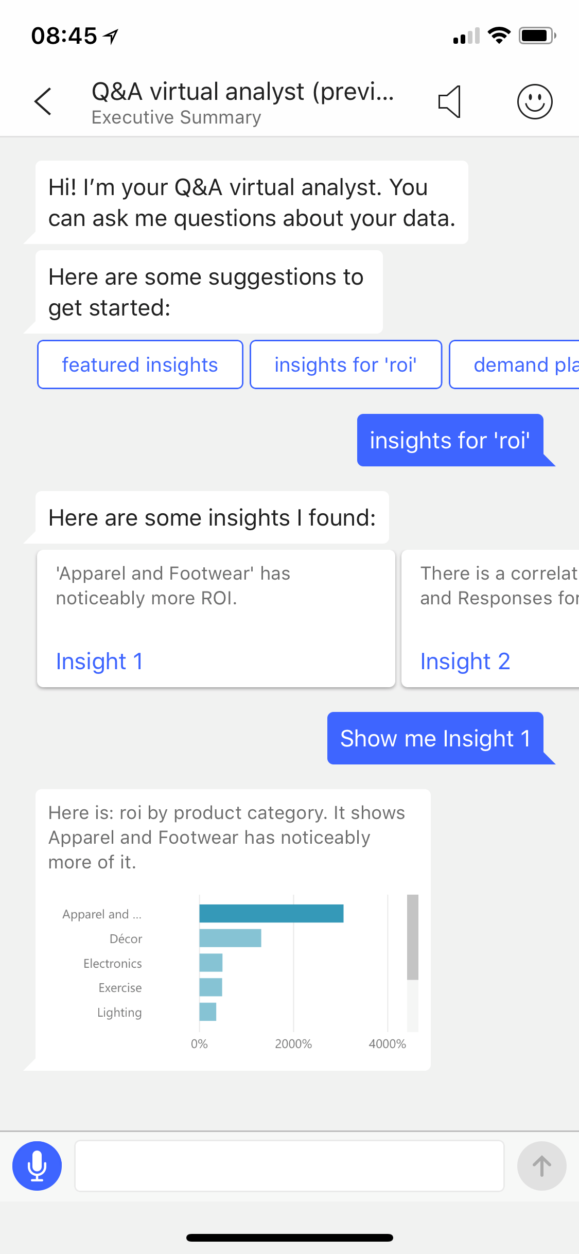
1
2
3
Stay connected to your data on the go

Slide 11
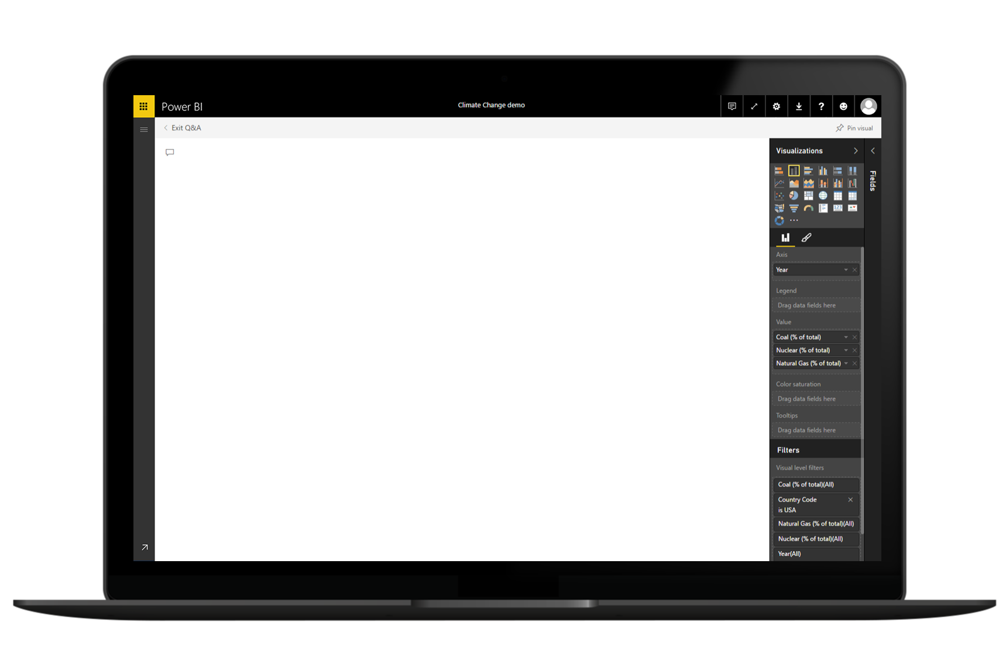
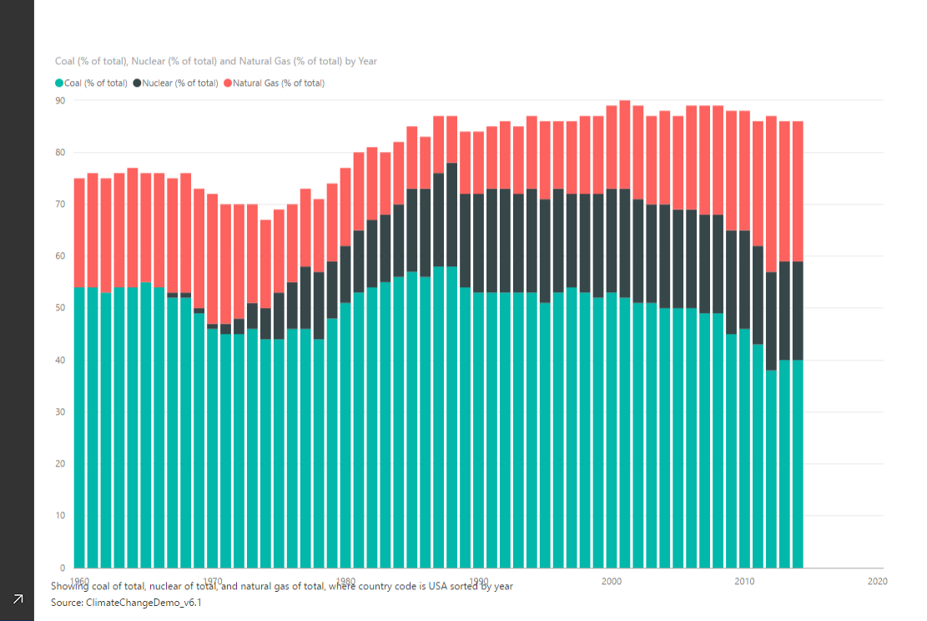
1
2
3
Electricity from coal, nuclear, gas per year in USA
Ask questions, get answers

Slide 12
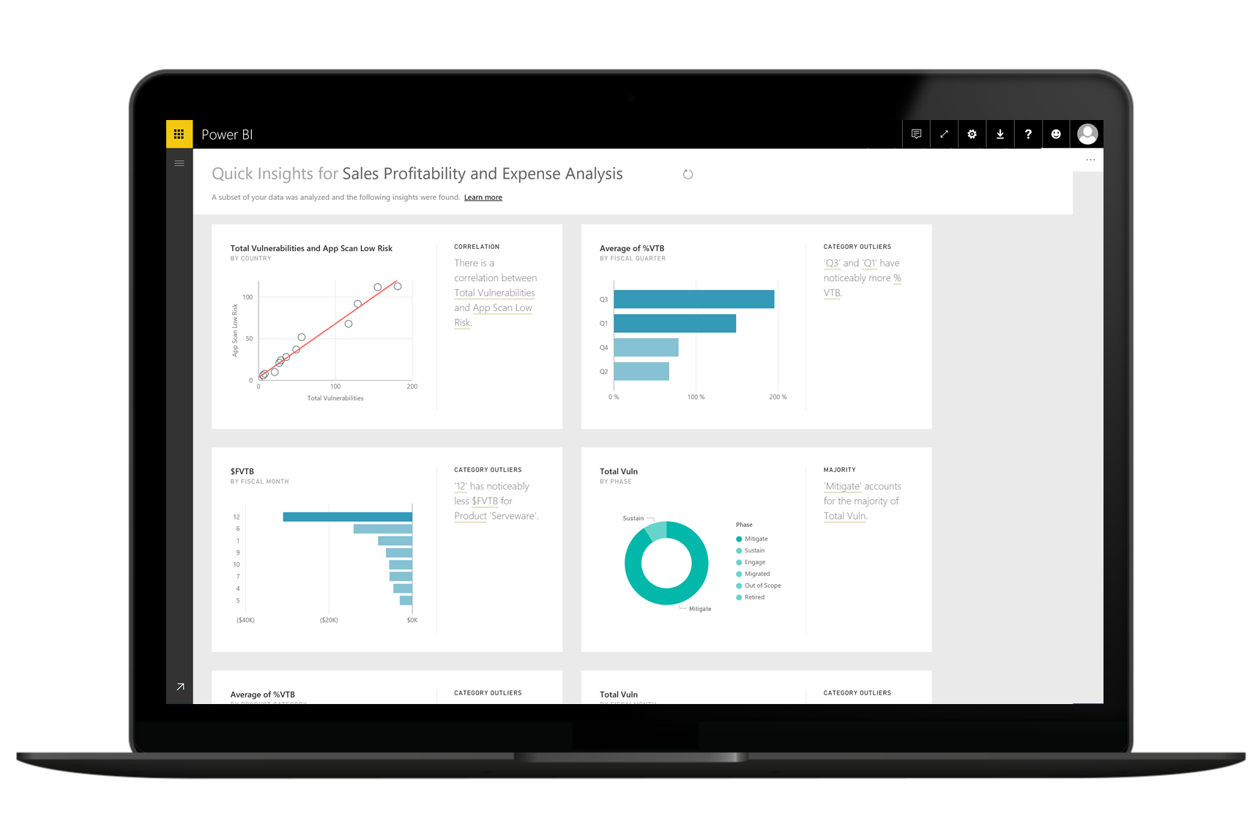
1
2
3
Automatically discover insights from your data

Slide 13

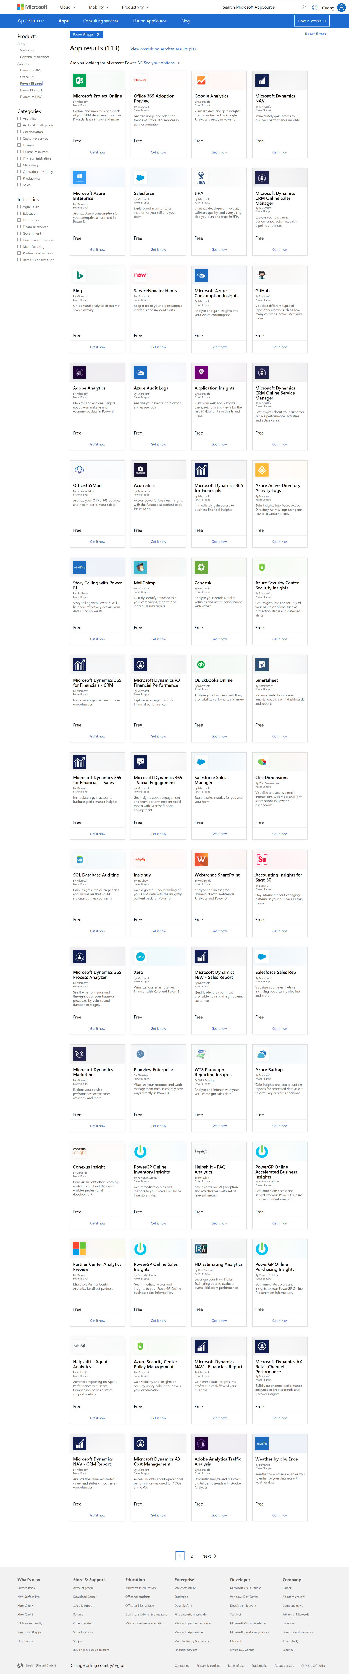
1
2
3
Accelerated deployment with pre-prepared content

Slide 14
1
1
2
2
3
3

Slide 15
1
2
3
Business Analysts
from Customers
to Advocates

Slide 16
1
2
3
Power BI Desktop = Free

Slide 17
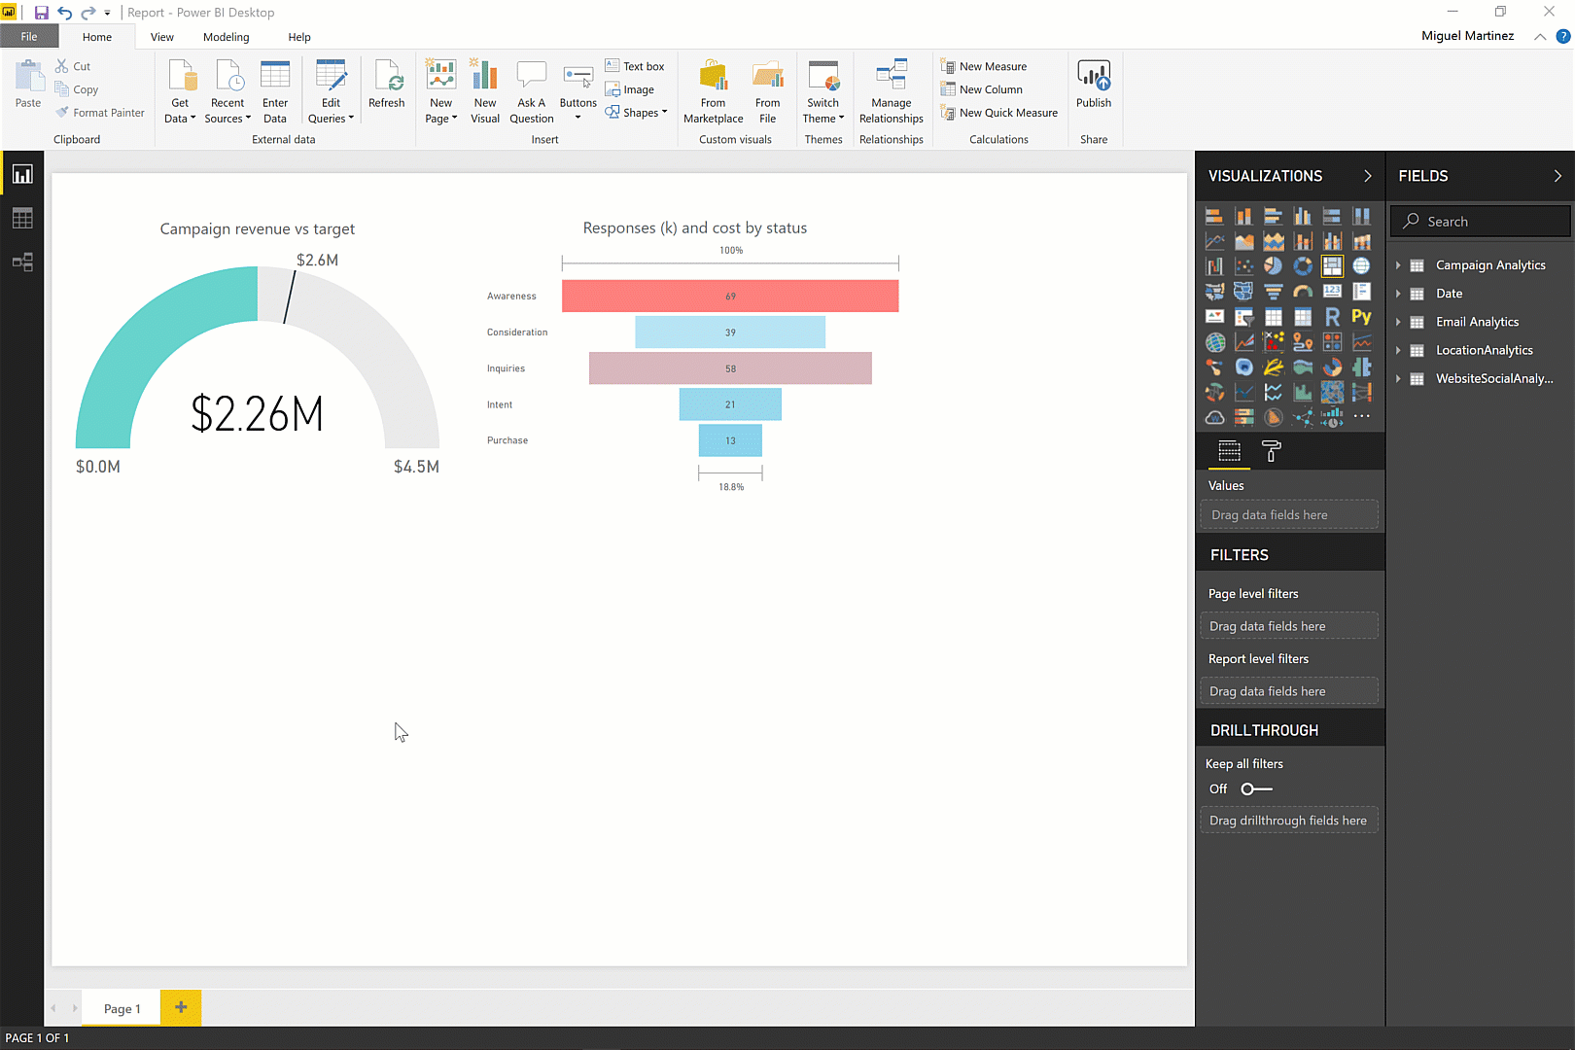
Create powerful reports with Power BI Desktop
1
2
3
Discovery & exploration
Easy report authoring
Custom visualizations
R integration

Slide 18
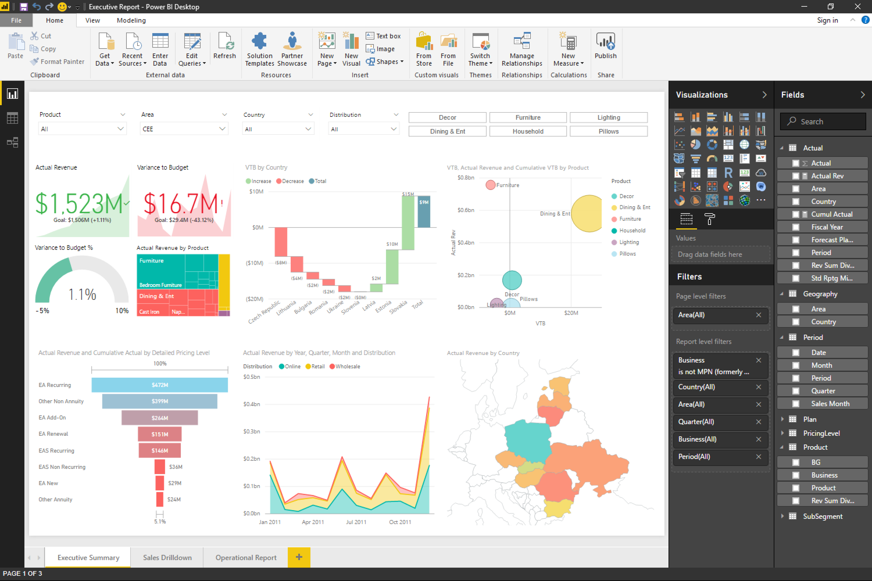
Create powerful reports with Power BI Desktop

Slide 19
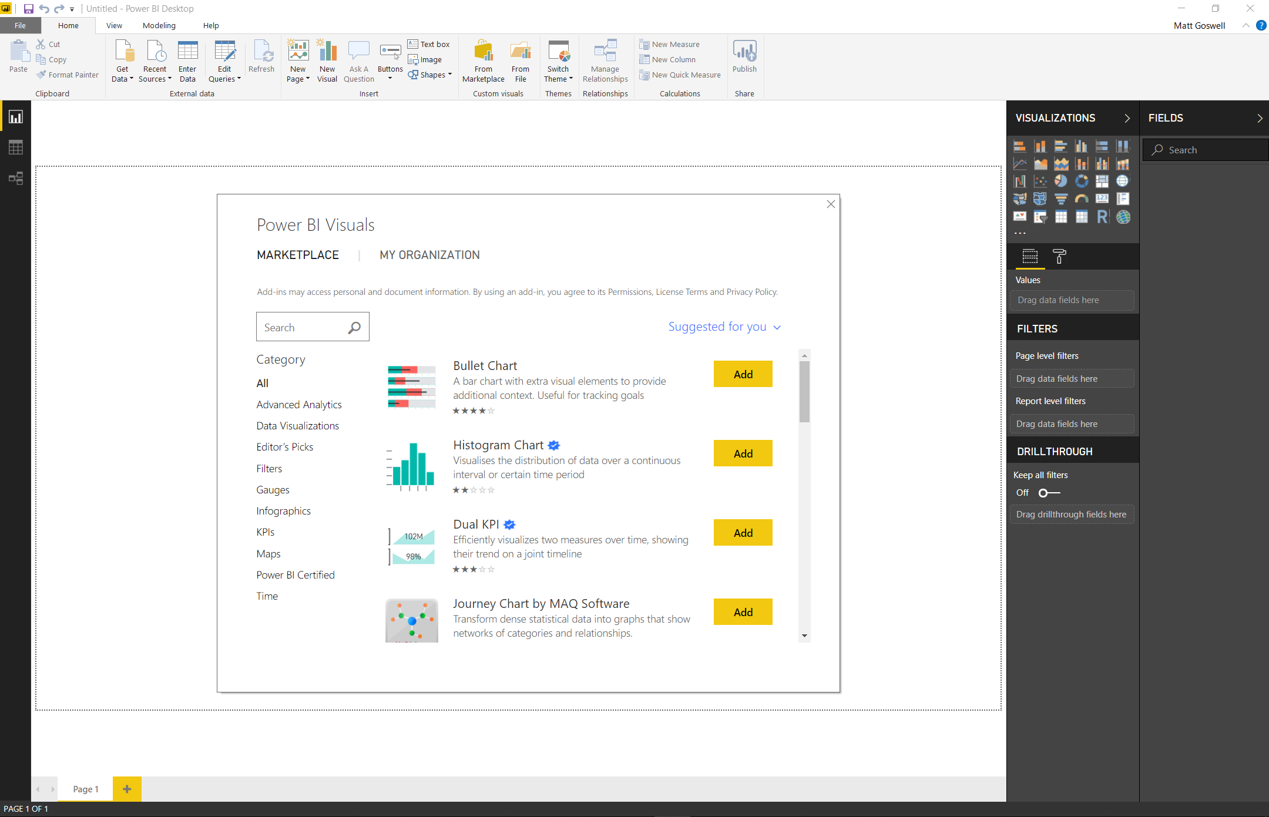
1
2
3
Explore your data in new ways with 150+ Power BI custom visuals

Slide 20
2
1
2
1
3
3

Slide 21
1
2
3
Disruptive Economics
$9.99
Power BI Pro user/month
for a fully managed cloud service

Slide 22
Easy to manage, cost-effective capacity-based usage with Power BI Premium
1
2
3
per user cost
$
Enterprise-scale modelling & ALM
Self-service data prep on big data
Consumption & Enterprise reporting
$

Slide 23










































Customer momentum: Power BI
Retail and consumer goods
Discrete manufacturing
Government and education
Healthcare
Banking and financial services
Professional services
Technology systems and services

Slide 24

20M
Data models hosted in the Power BI service
10PB
Of data uploaded to Power BI/month
Today
9M+
Report and dashboard queries/hour
700K Active community members
200+ Independent Power BI user groups worldwide

Slide 25
20M
Data models hosted in the Power BI service
10PB
Of data uploaded to Power BI/month
9M+
Report and dashboard queries/hour
700K Active community members
Today
200+ Independent Power BI user groups worldwide
350 Partner Solutions in Showcase
678 Partners available in 100+ countries

Slide 26
700K Active community members
200+ Independent Power BI user groups worldwide
350 Partner Solutions in Showcase
Today
1000+ Partners available worldwide

Slide 27
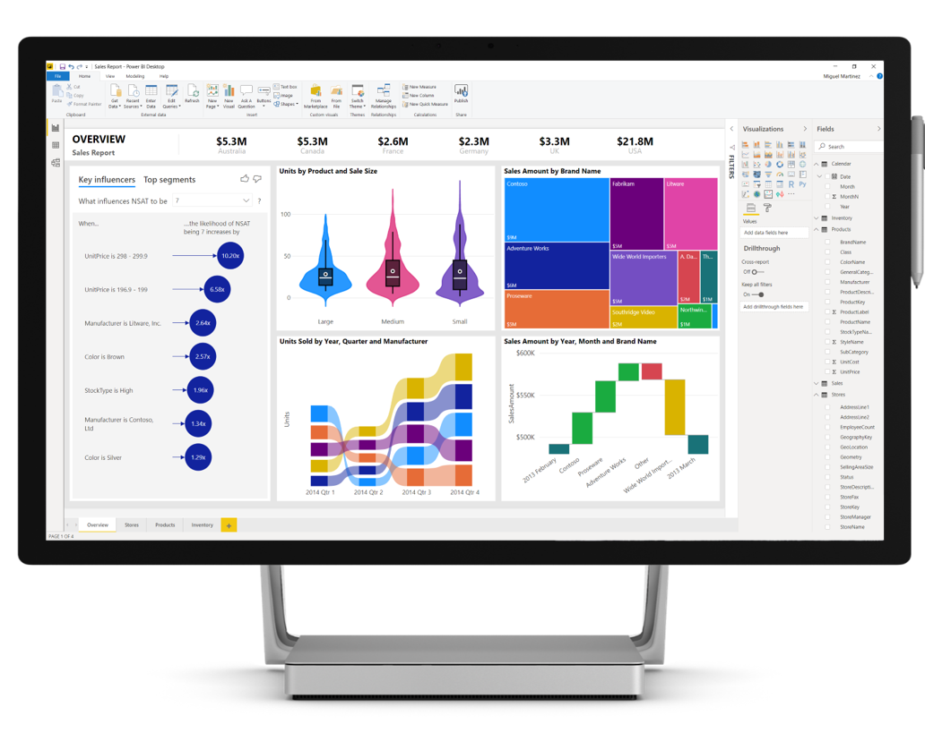
So what is Power BI Desktop?

Slide 28


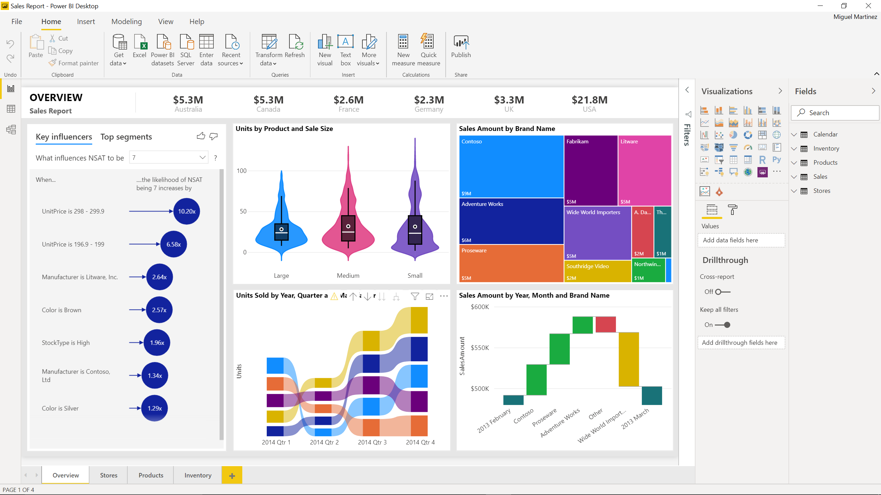





Microsoft Power BI Desktop
Get Data
Analyze
Visualize
Visualize
Power BI Desktop is a free companion authoring tool for the Power BI service, updated monthly with new features
Publish
Collaborate

Slide 37
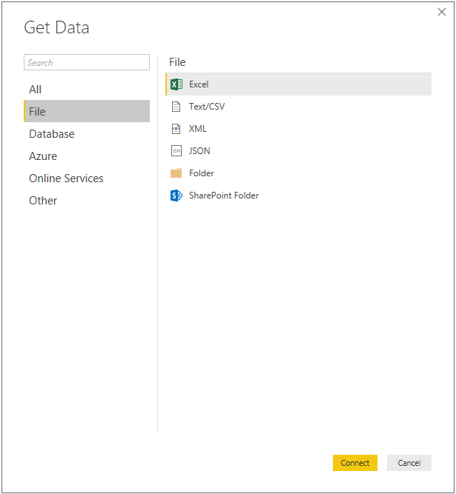
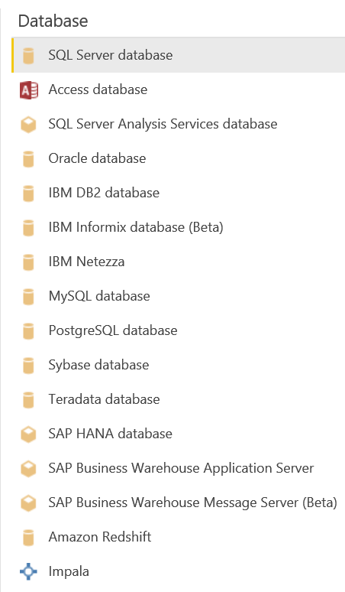
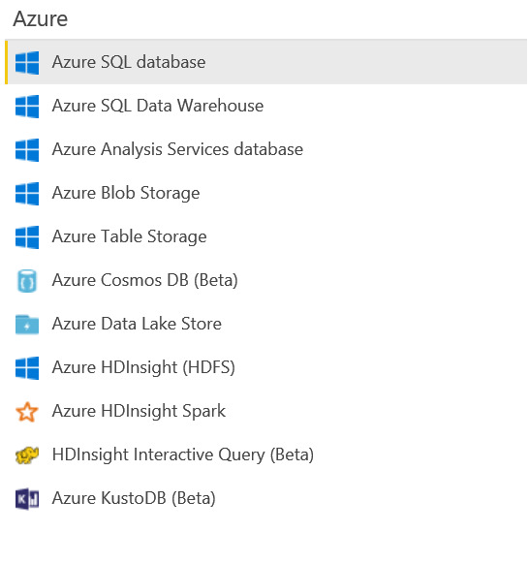
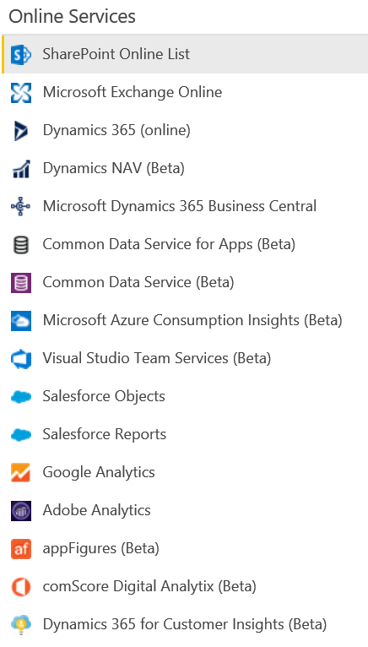
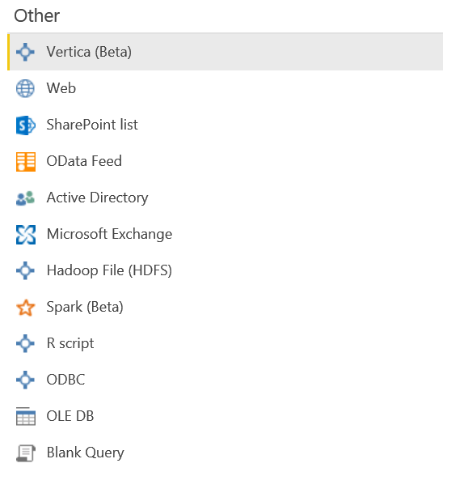
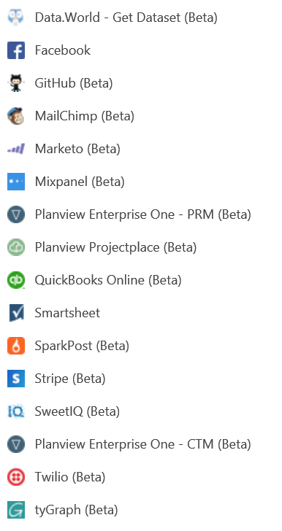
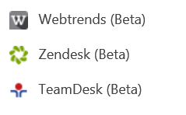
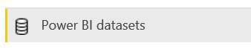
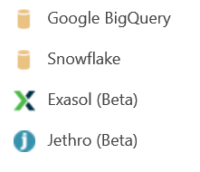
Data sources Over 80+ data sources and growing

Slide 38
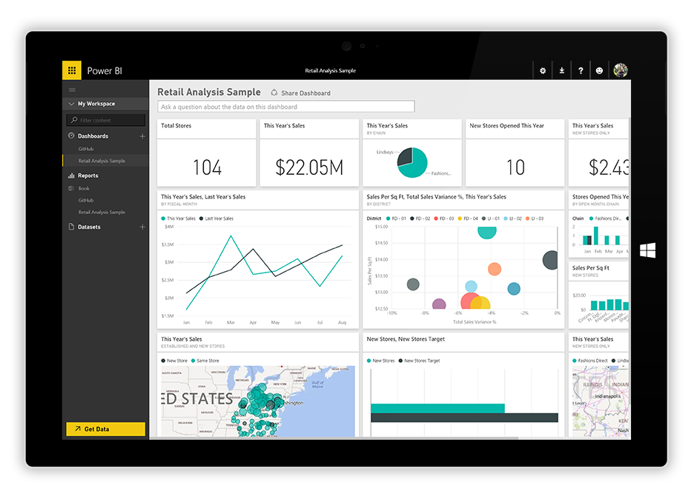
Better together with the Power BI service
One-click to publish to Power BI service.
Automatic data refresh.
Email subscriptions and alerts.
Sharing and collaboration.
Access anywhere, on any device.
Administrative capabilities.

Slide 39
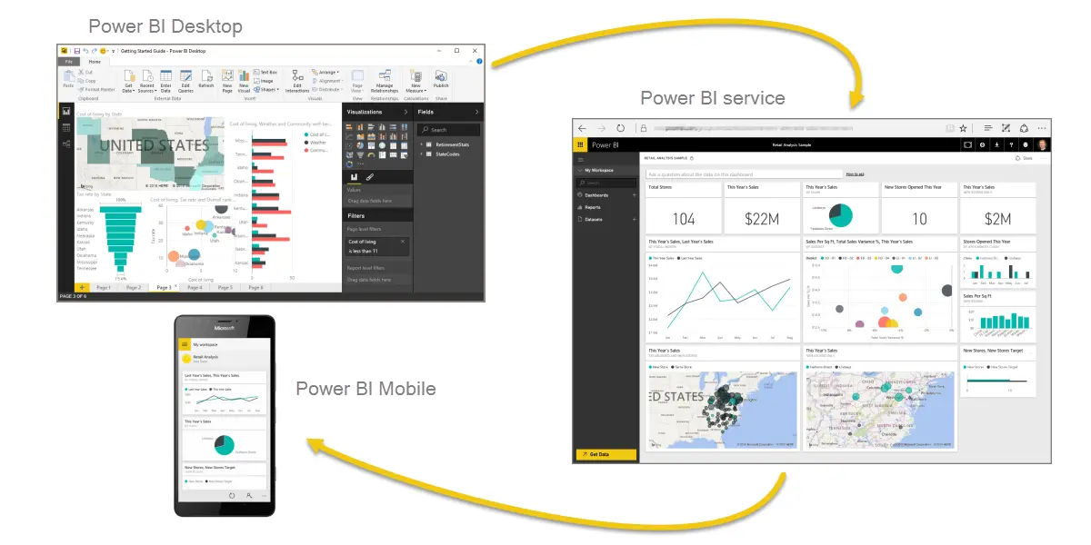

Slide 40

Using a Query in multiple Files

Slide 41
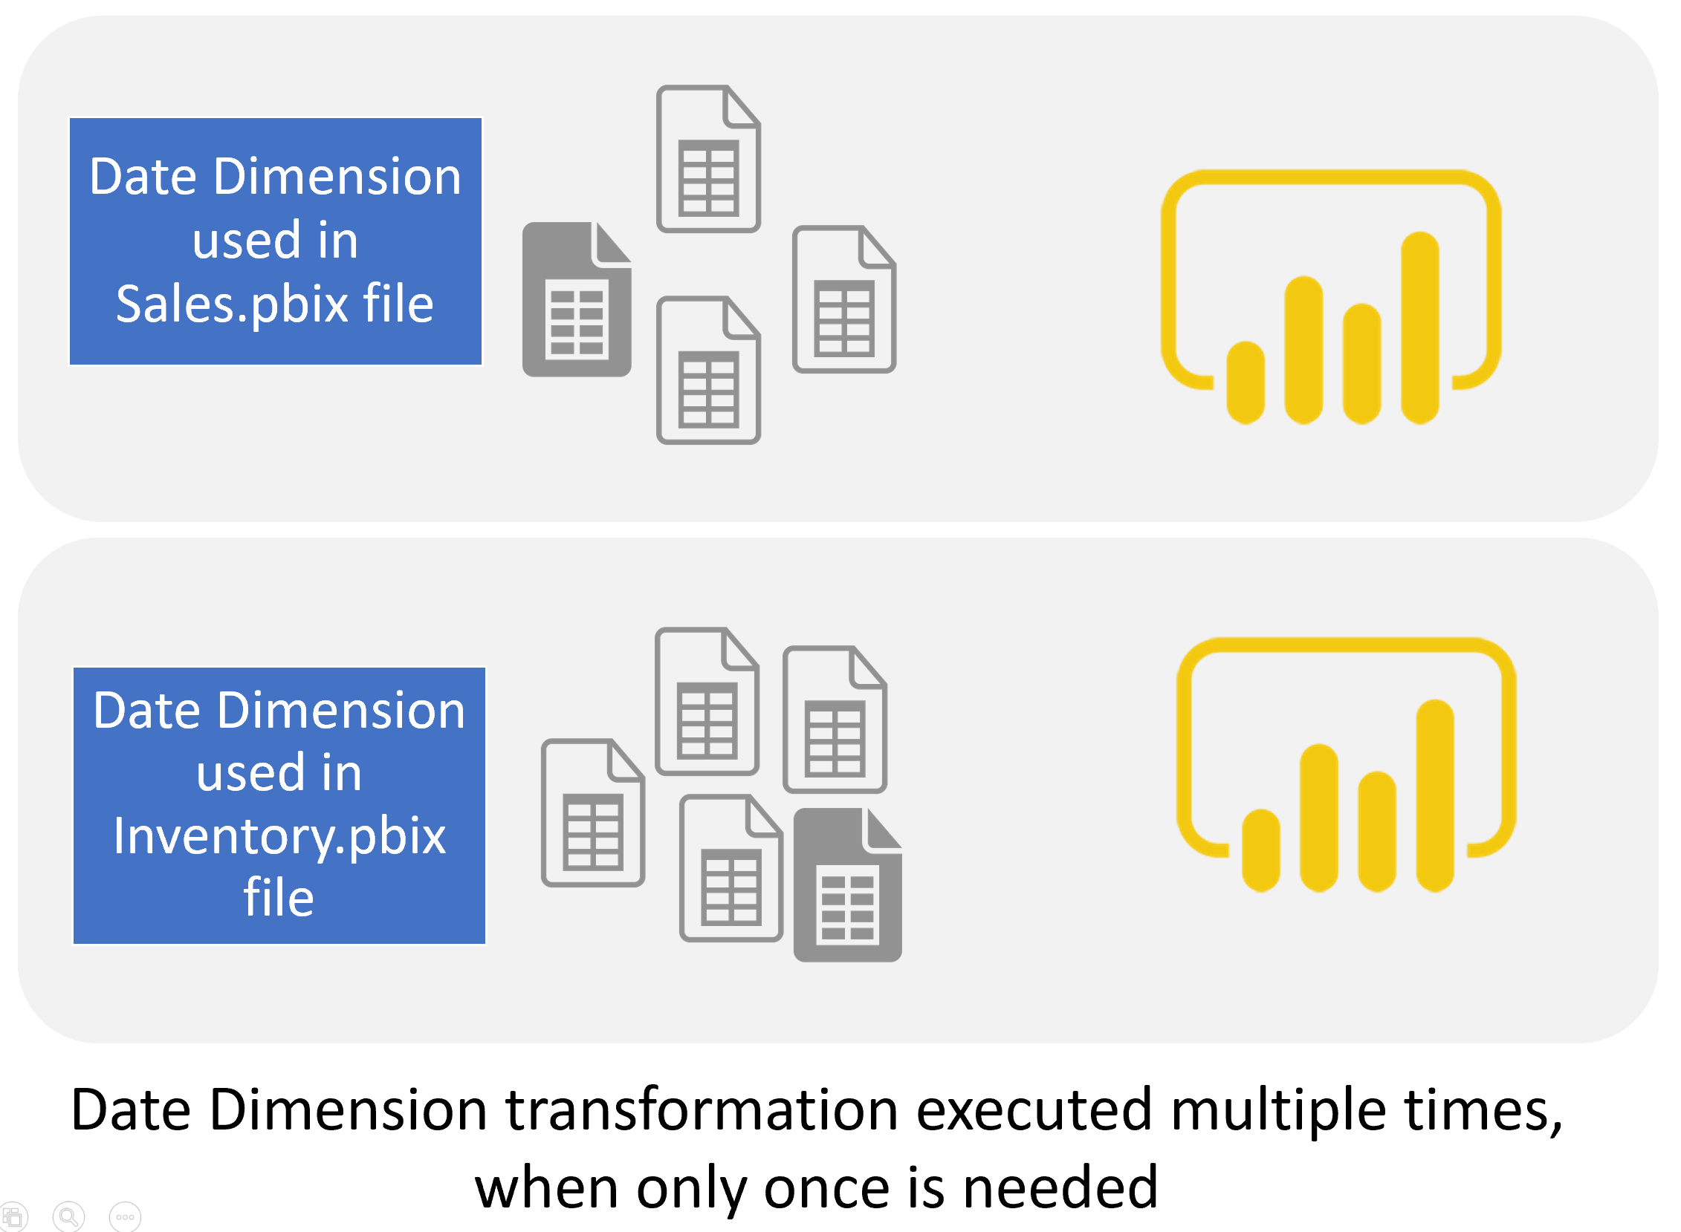
Using One Power Query Table in Multiple Power BI Reports

Slide 42
What is Dataflow?

Slide 43
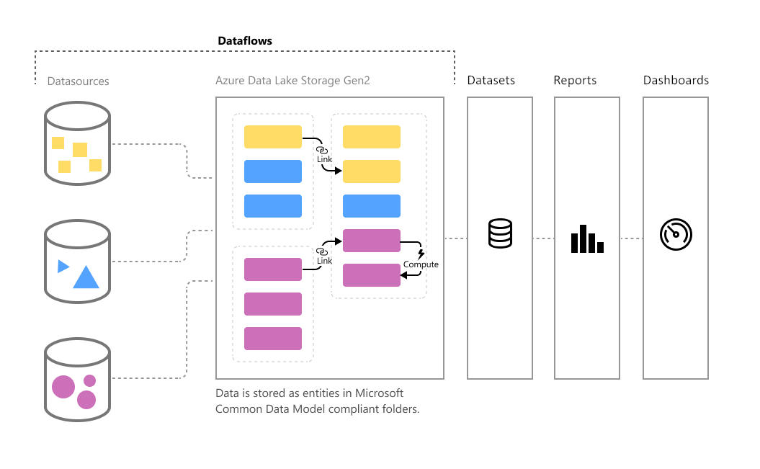
What is Dataflow?
Dataflow is a Power Query process that runs in the cloud independently from any Power BI reports.

Slide 44
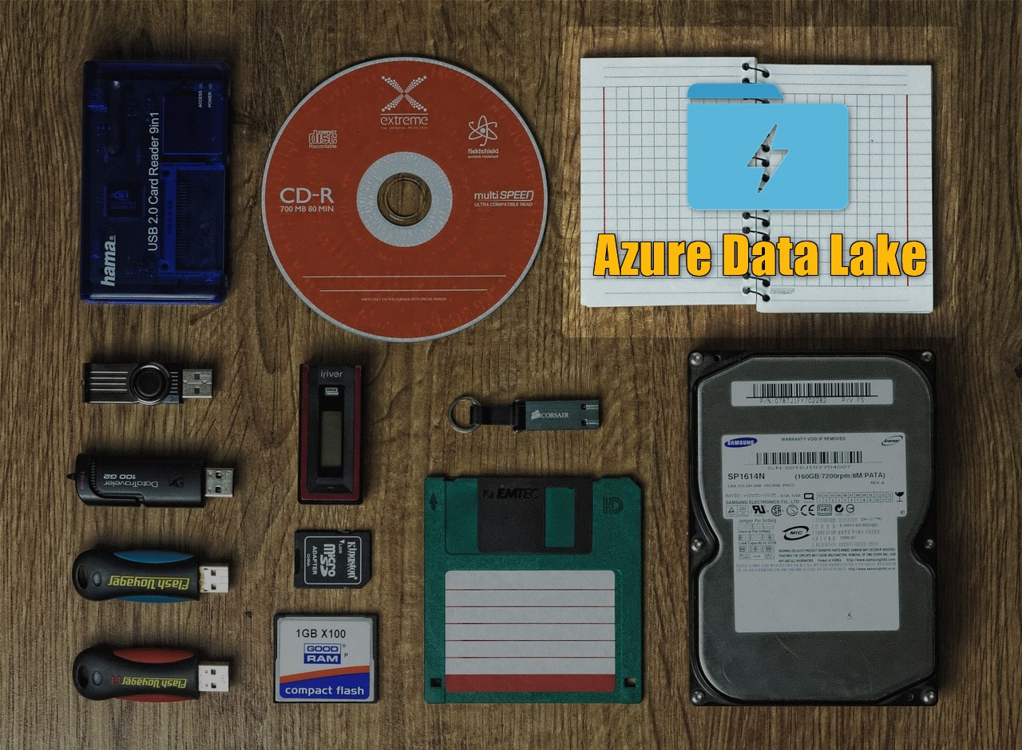
Where the Output Stored?
Dataflow stores the data in the Azure Data Lake storage.

Slide 45

But I Don’t Have Azure Data Lake Subscription!
Dataflow manages the Data Lake configurations internally. You won’t need anything except your Power BI accounts and subscriptions.

Slide 46
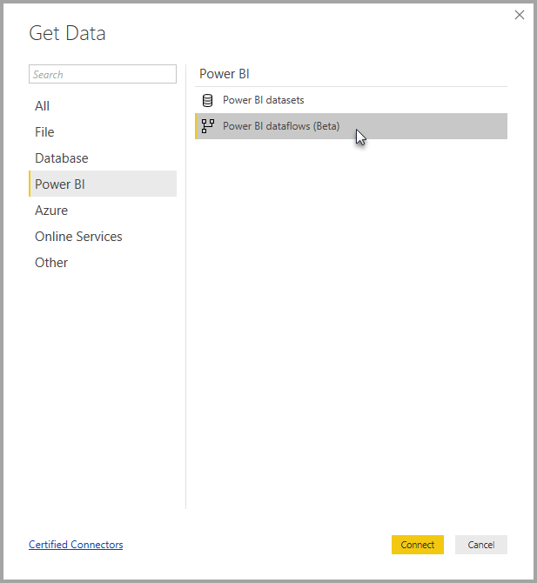
Power BI Can Do Get Data from Dataflow

Slide 47
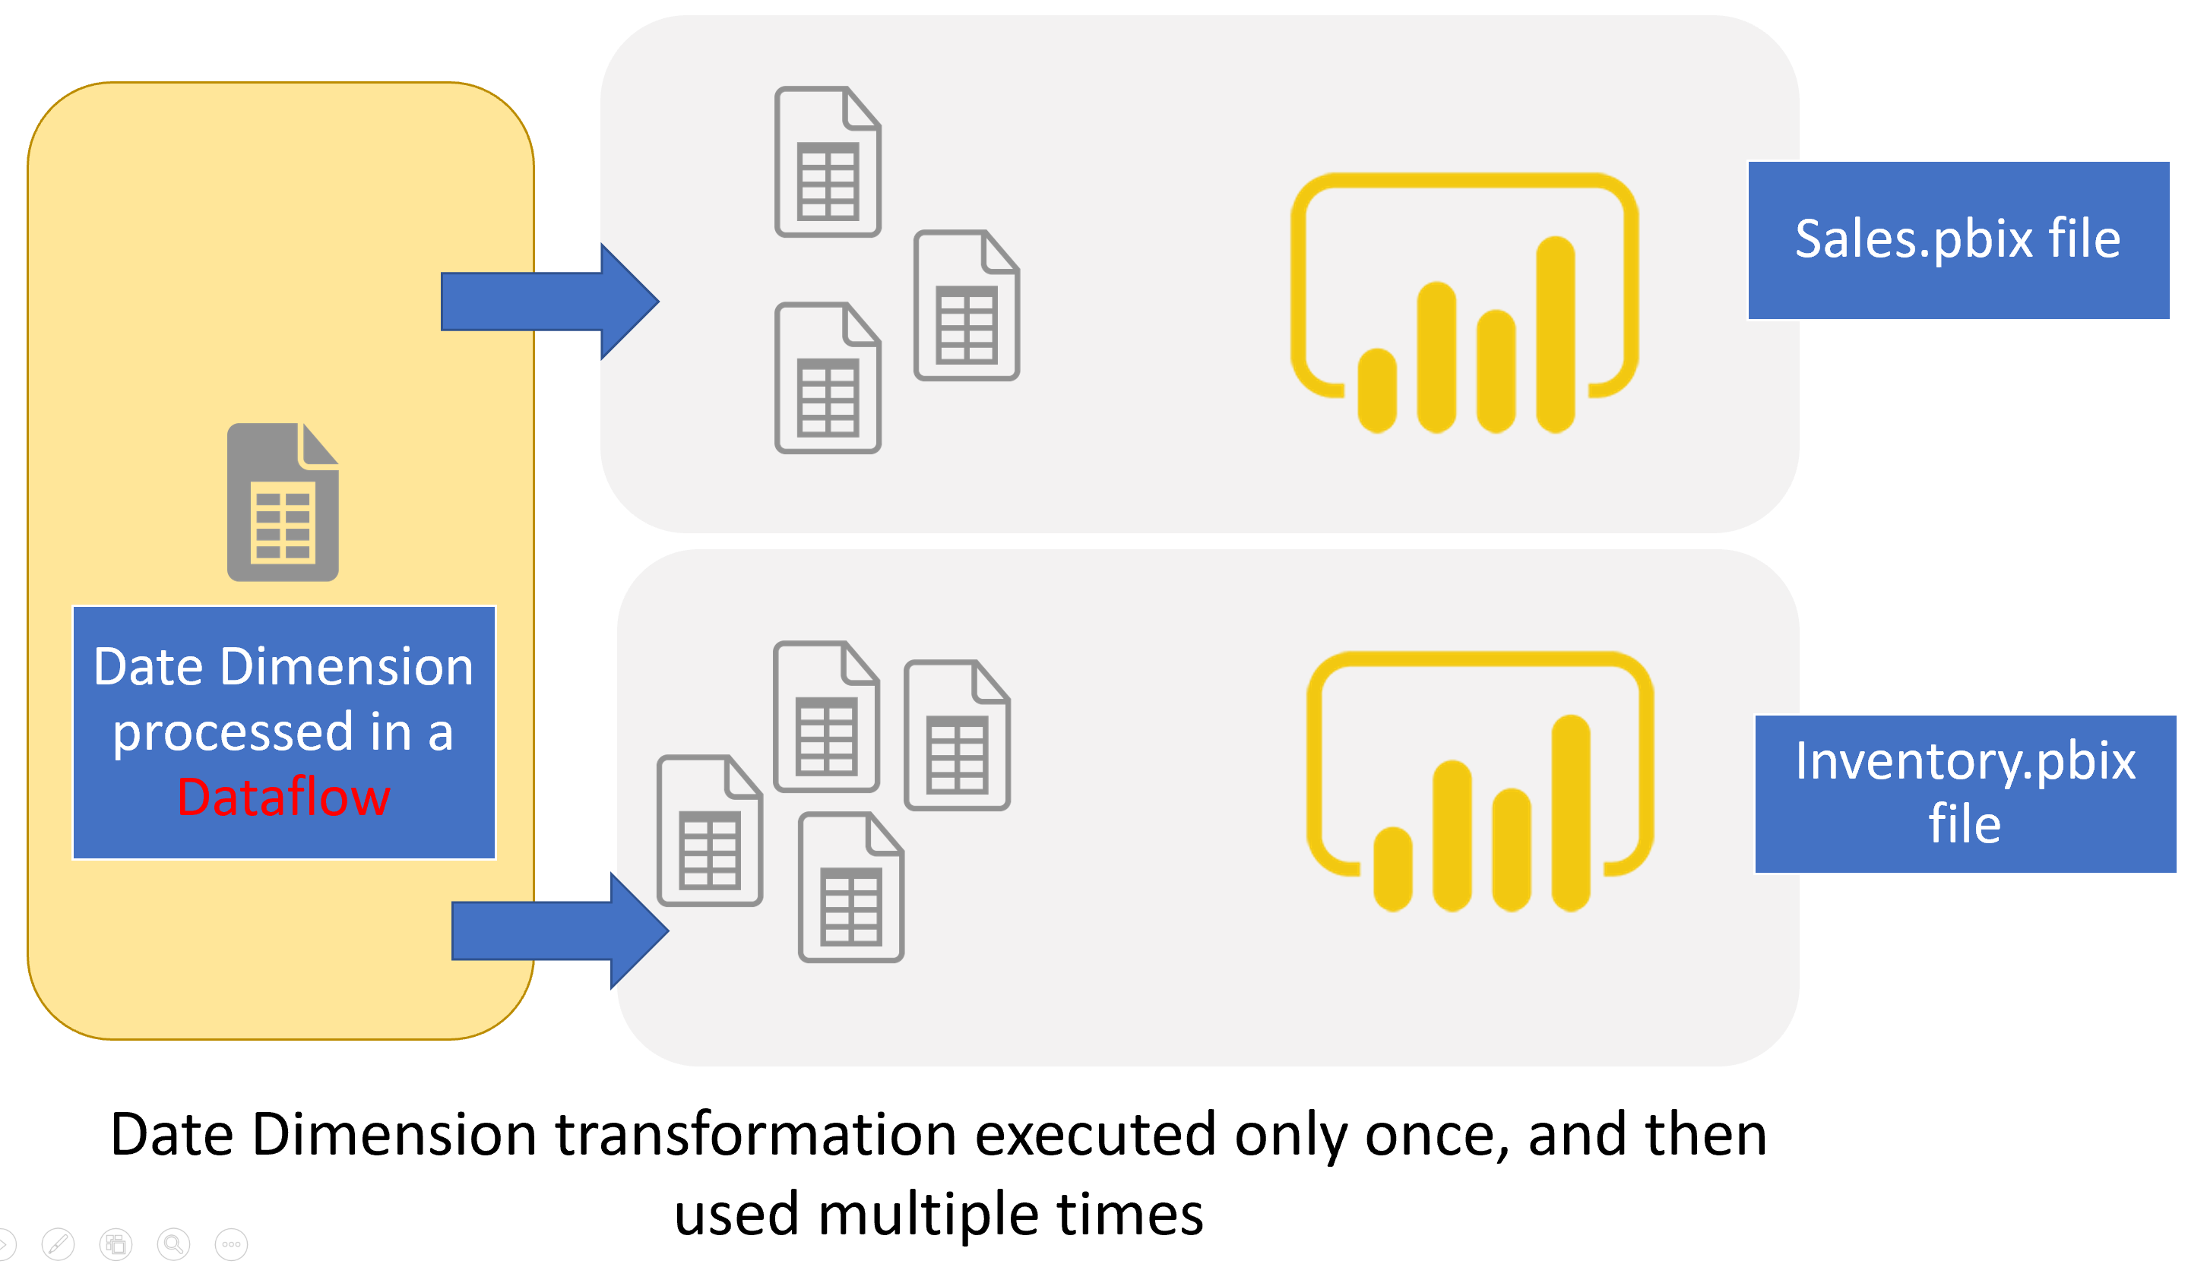
Using One Power Query Table in Multiple Power BI Reports
Re-usable tables or queries across multiple Power BI files, are one of the best candidates for Dataflow.

Slide 48
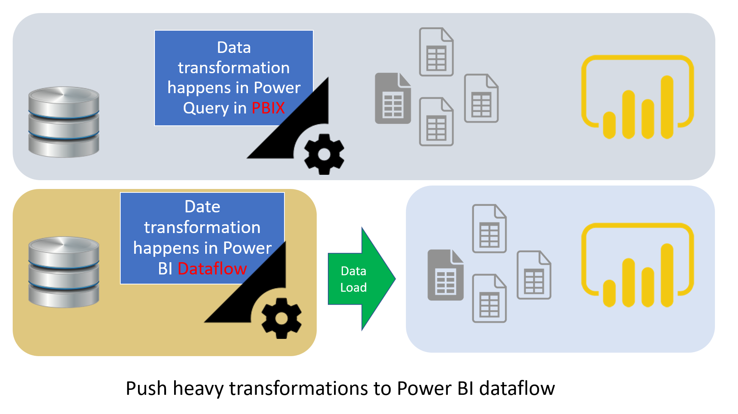
FASTER refresh time

Slide 49
Using a Calculation (DAX) in multiple files

Slide 50
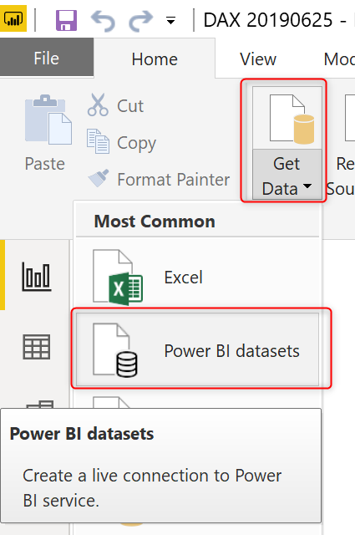
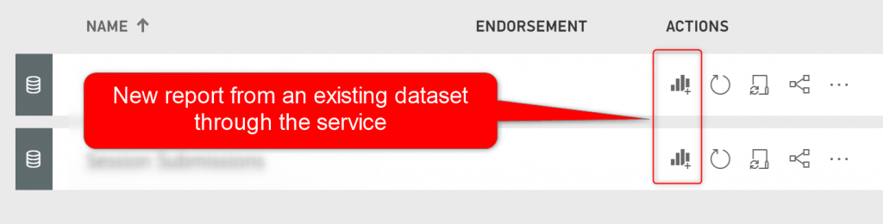
Shared Dataset
Dataset used in multiple reports

Slide 51
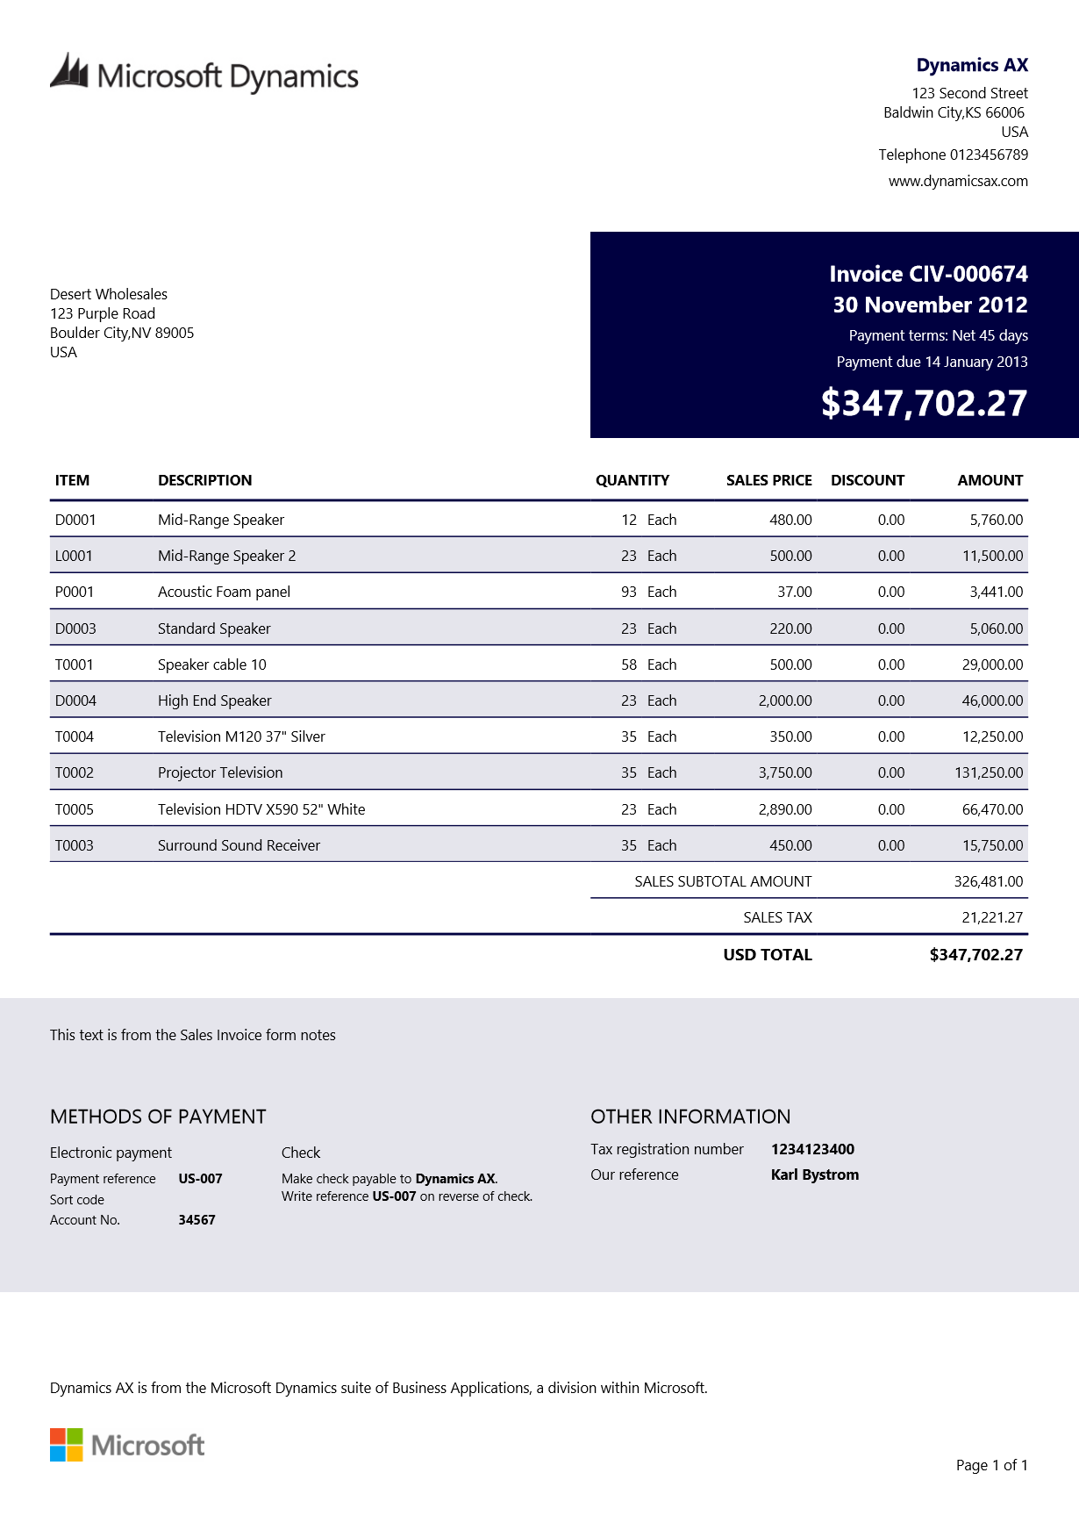
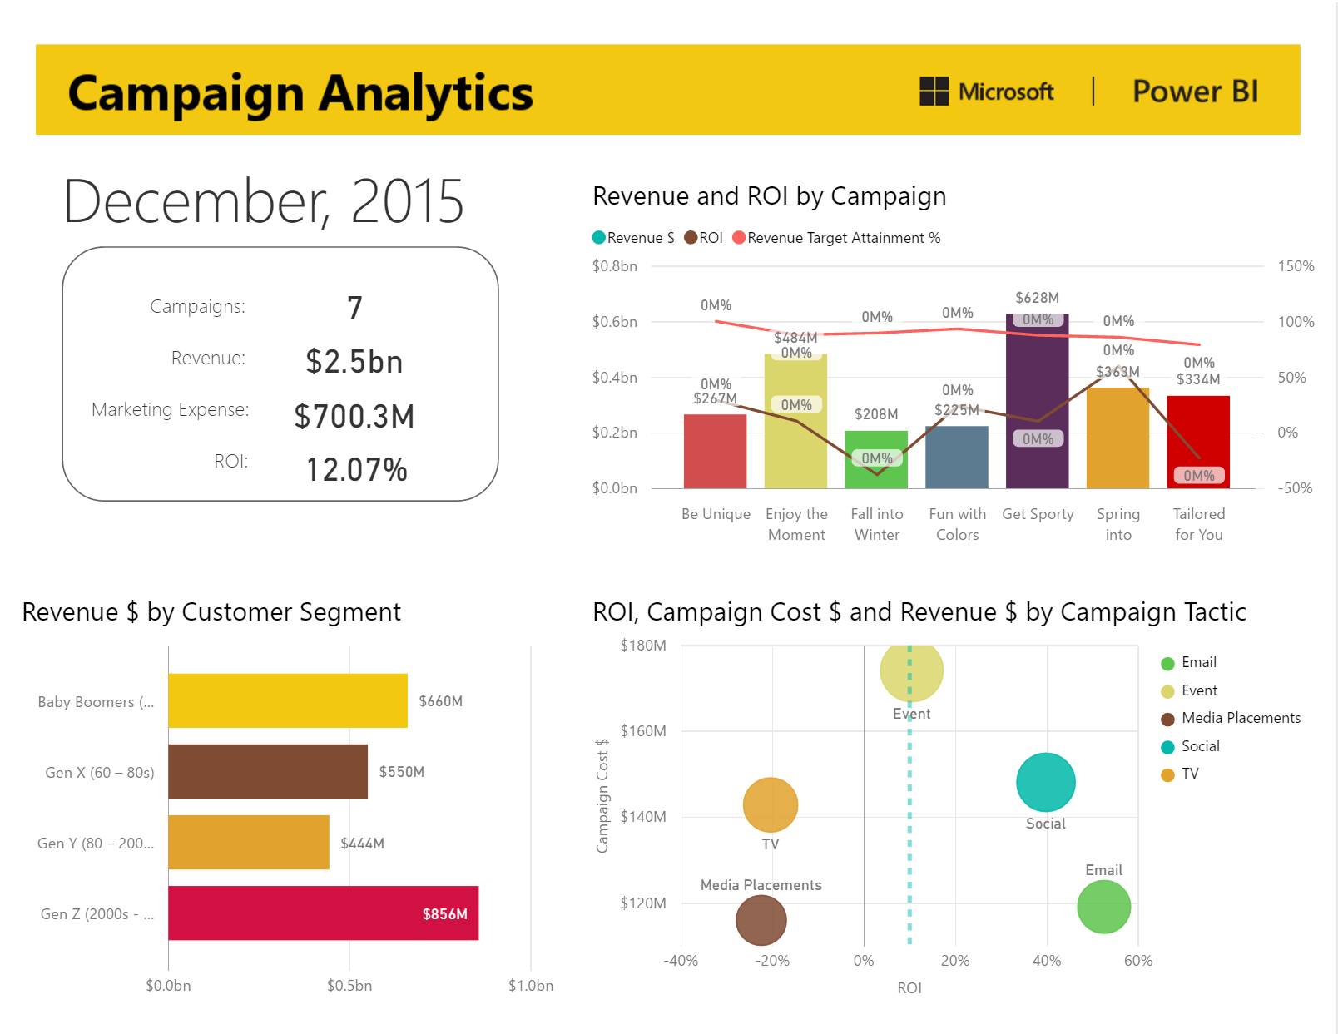
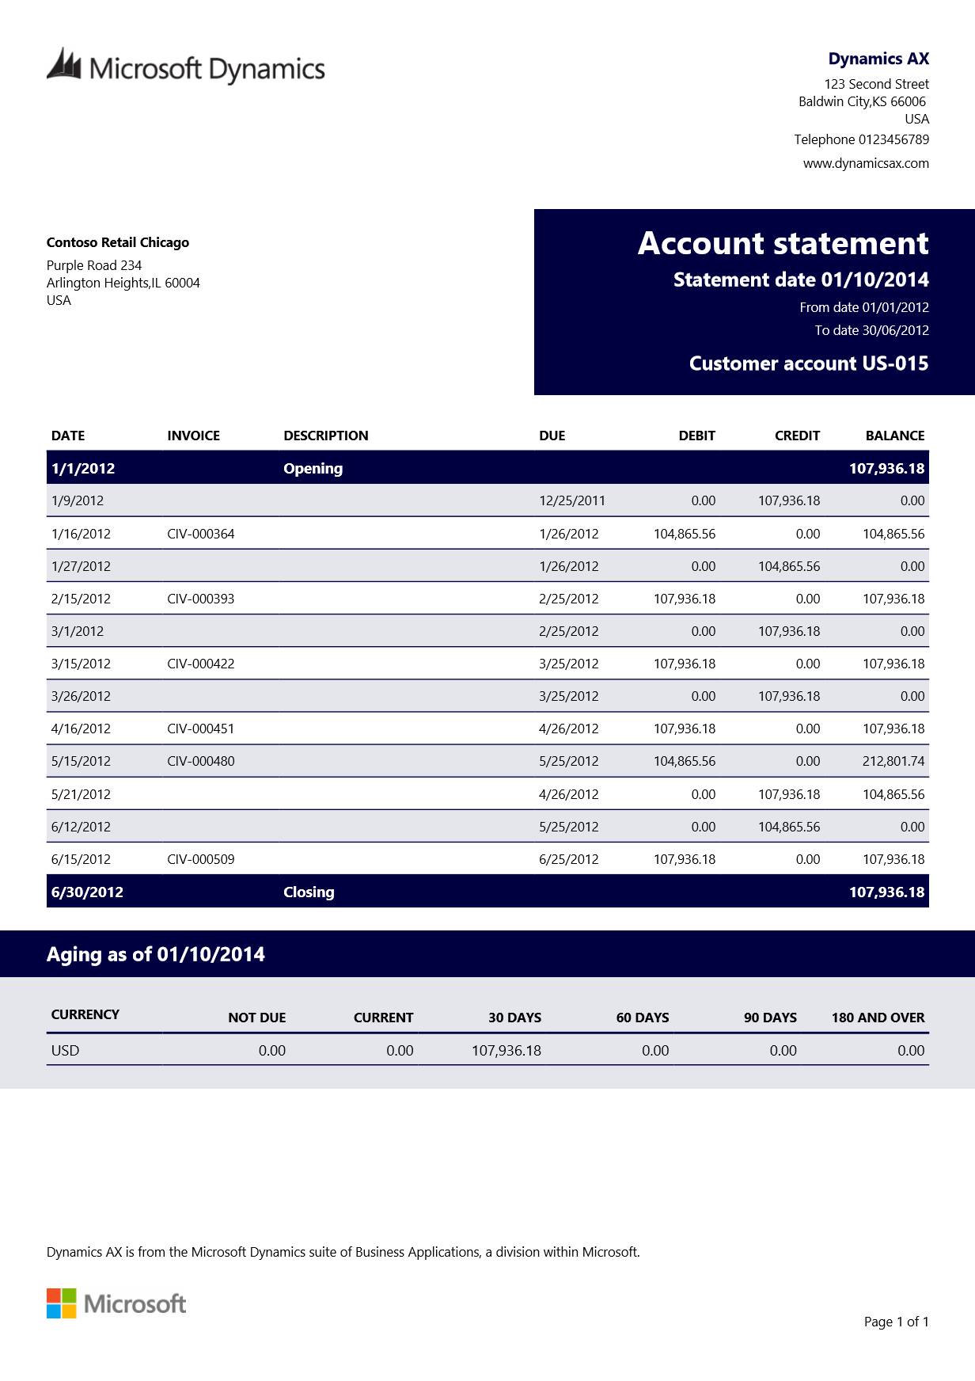
Paginated reporting vs. analytics
Analytical reports (PBIX)
On-screen interactive data analysis to discover insights, inform decisions
Paginated reports (RDL)
Documents generated from data and used in business processes

Slide 52
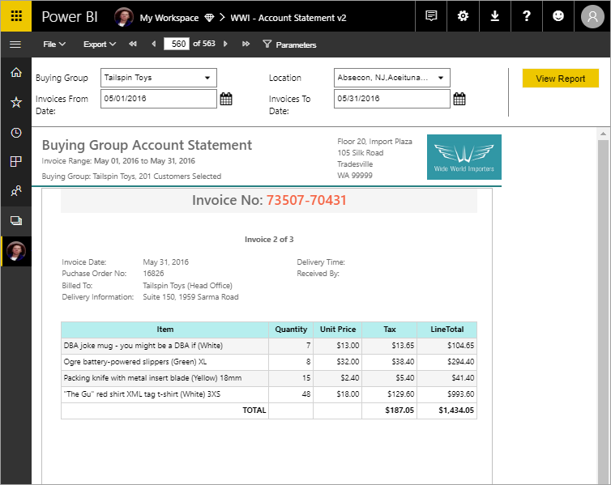
Paginated Reports
Build for printing, export to PDF, paginated…

Slide 53
Paginated in Power BI: Medium term vision

Slide 54
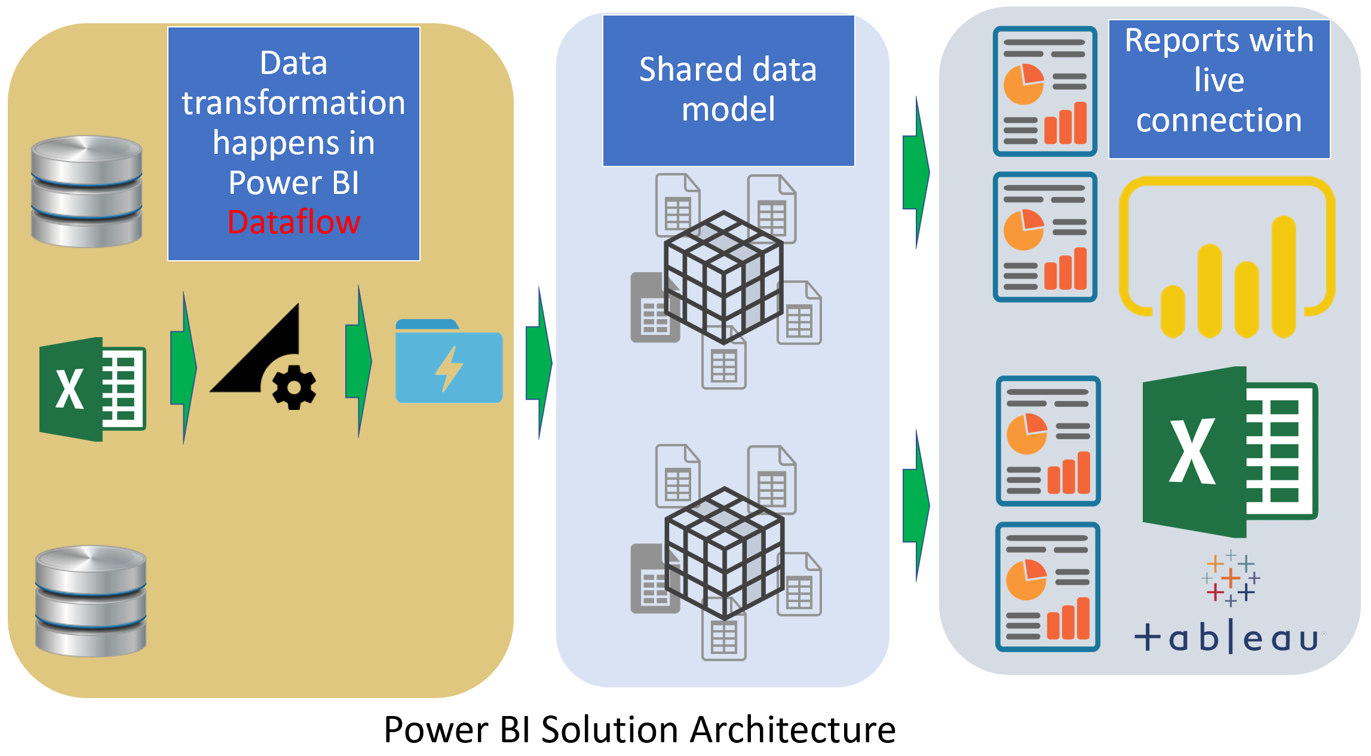
Power BI Architecture for Multi-Developer Tenant Using Dataflows and Shared Datasets

Slide 55
Benefits of this architecture
Decoupling Data preparation, Modelling, Visualization
Faster Refresh Time for Power BI model
Dataflow is not a core developer tool
Multi-Developer Environment
Re-use of Calculations and Modeling

Slide 56
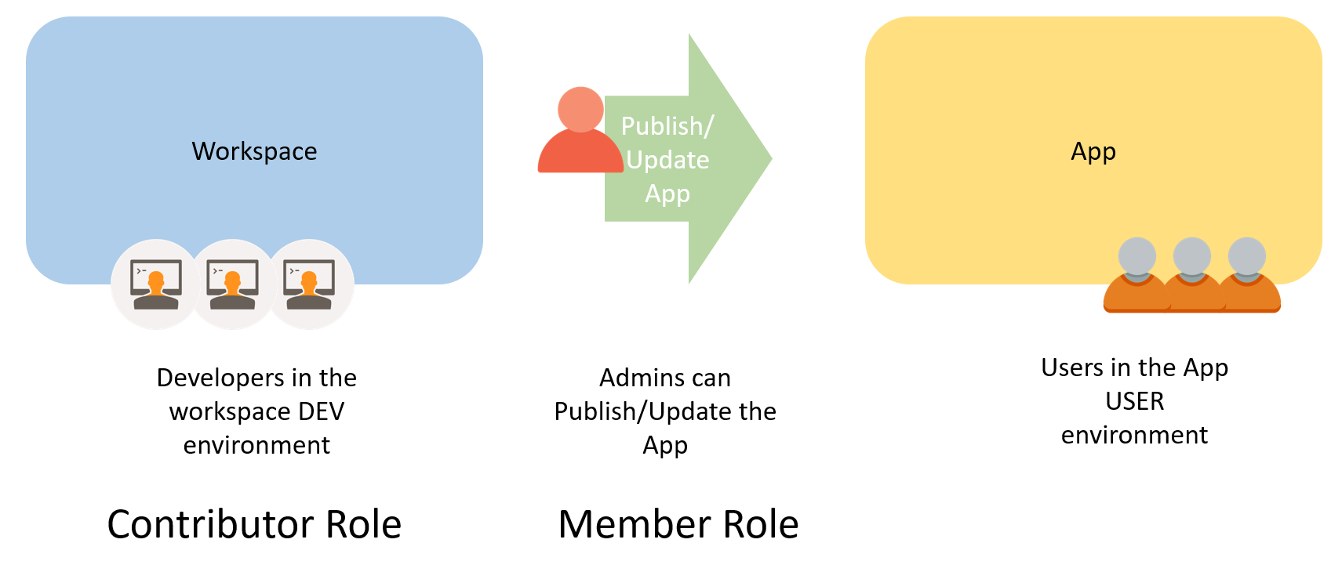
Sharing via Workspaces and Apps

Slide 57
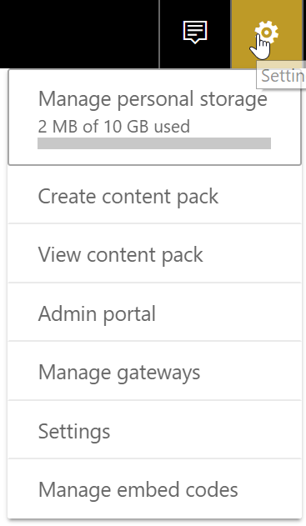
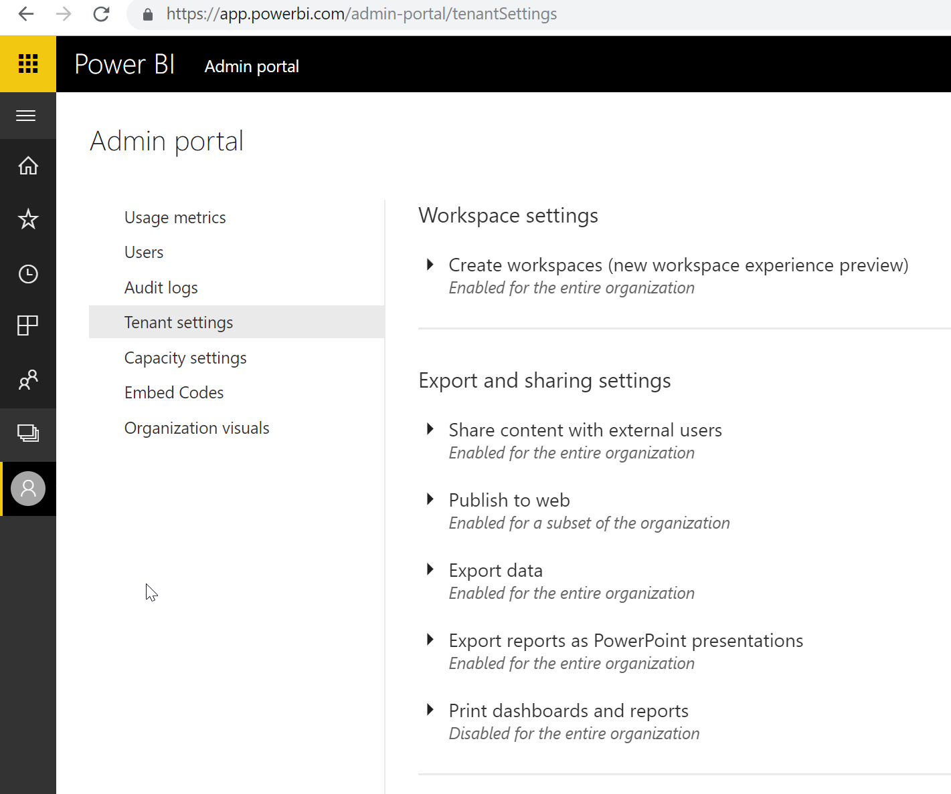
Power BI Admin Portal enables your control
A portal to configure Power BI for your organization’s needs.
Control exposure of your data
Disable Publish to web
Set who can share externally
Set who can export data
and many more…

Slide 58
Administrator roles related to Power BI
Administrator type | Scope
Office 365 Global Administrator | Office 365
Office 365 Billing Administrator | Office 365
Power BI Service Administrator | Power BI (Defined in Azure AD/O365)
Power BI Capacity Administrator | A single capacity (Premium or Azure)
Power BI App Workspace Administrator | A single app workspace

Slide 59
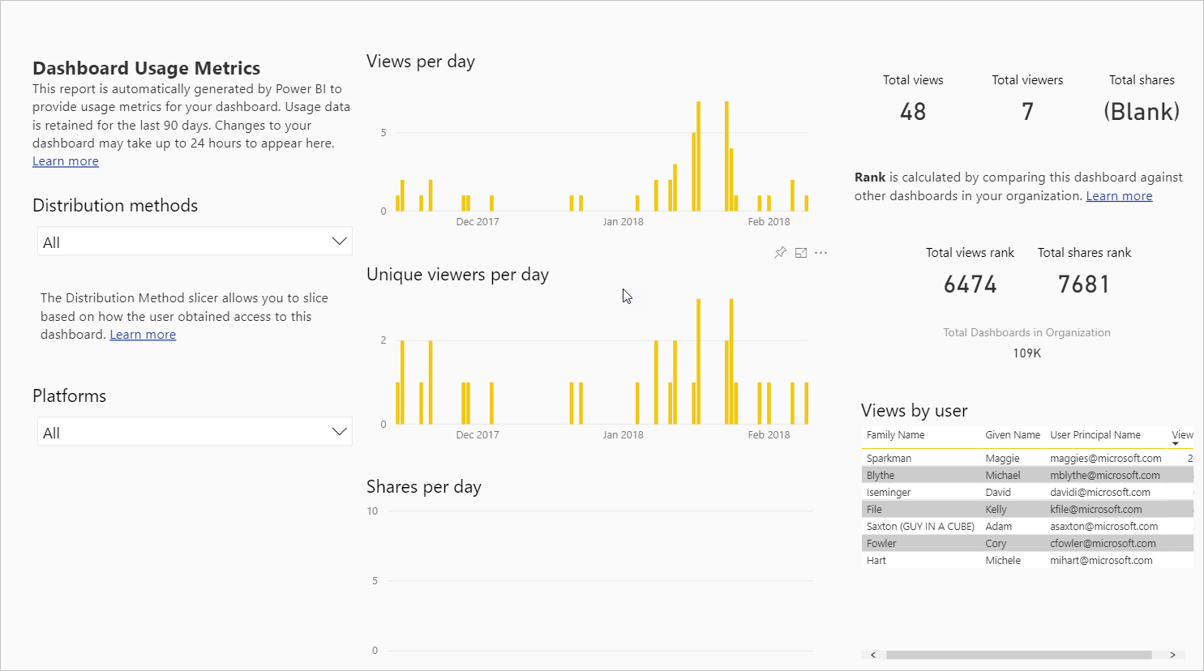
Usage Metrics
Ability to see usage of individual dashboards and reports
May differ from audit log numbers due to how it is collected
Can work with underlying dataset

Slide 60
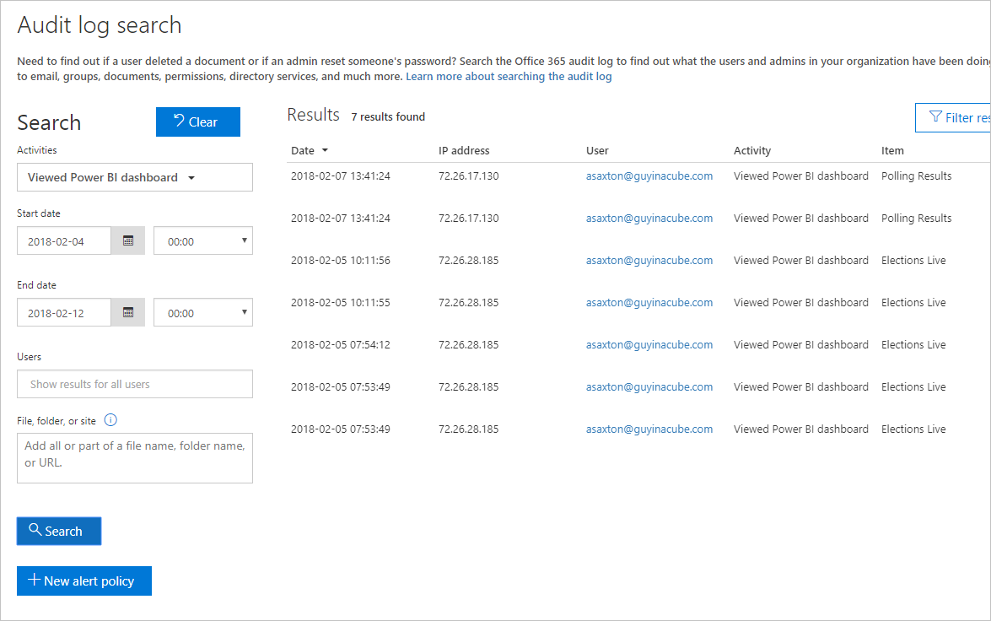
Audit logs
Requires Exchange Online license
Disabled by default
Can use data to understand usage in Power BI Tenant
Data is retained for 90 days
In-Region Auditing
PowerShell access

Slide 61
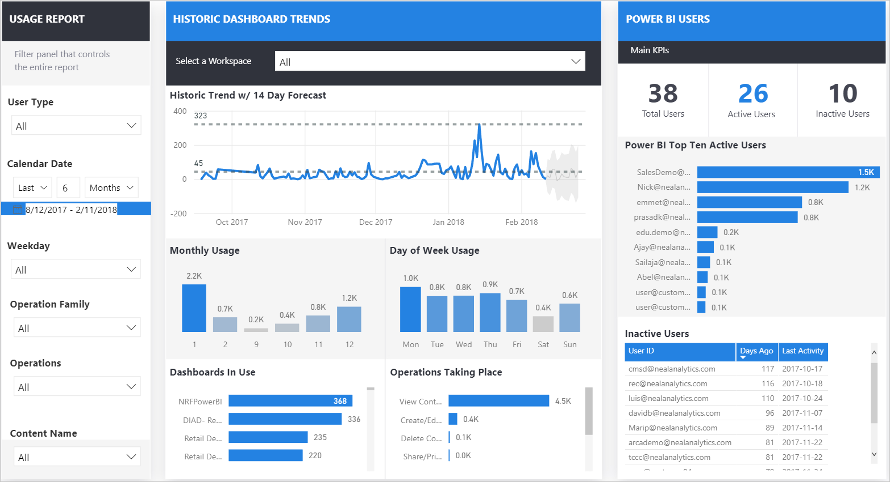
Power BI Usage Metrics Solution Template
Based on O365 Management API
Curated data model and report
NOTE: Azure and Licensing costs apply!

Slide 62
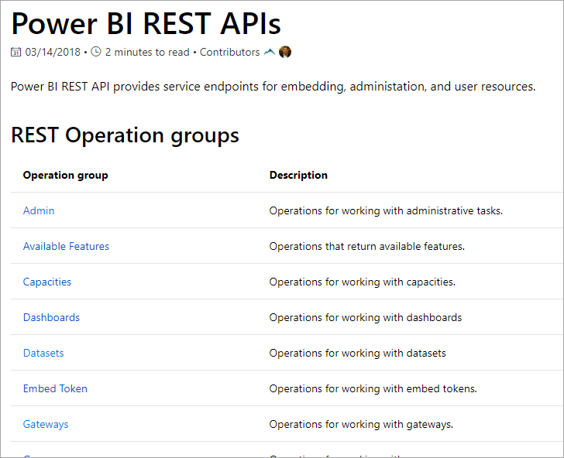
REST APIs
Used to interact with the service
Embedding
DevOps
(Trigger refresh, Clone items, etc…)
Administration
(See all assets)
https://docs.microsoft.com/rest/api/power-bi/

Slide 63
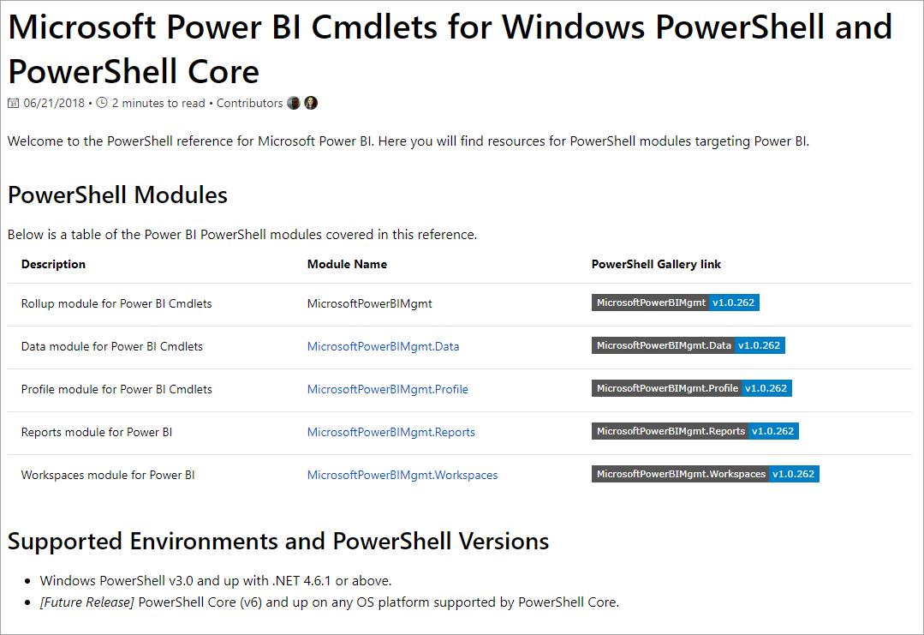
PowerShell
MicrosoftPowerBIMgmt cmdlet
Individuals or Admins
Call a REST API directly without App registration!
https://docs.microsoft.com/powershell
/power-bi/overview?view=powerbi-ps

Slide 64

Demo
Building your Power BI report for Dynamics 365

